Slide 1



How Can IoT (Sensors) & Machine Learning Help Beekeepers Maintain Their Hives With Minimal Colony Loss And Visualise The Data Collected To End User
Author: Ahmed Bazina
Student No: ST20119000
Supervisor: Dr Thanuja Mallikarachchi

Slide 2

Problem
Cost effective solution for beekeepers
What does the collected data mean?
How can the data benefit the beekeeper?
What sort of algorithm can be used?
Notes:
This research explored the advantages of beekeepers’ usage of the Internet of Things or more accurately Internet of Bees. Previous studies have focused on data collection and user needs, the approach to focus on user understanding and data simplification through the utilisation of sensors in the beekeeping field. This research illustrated how beekeepers as users might benefit from the adoption of Internet of Things sensors and the value, they may obtain from them. This research project aimed to analyse the data from Kaggle and create a predictive algorithm that predicts relevant parameters that beekeepers require such as weight increase based on temperature, humidity, and flow. The project also aimed to create an effective and sustainable solution for beekeepers to better manage their apiaries with minimum colony loss by embedding IoT sensors and machine learning into hives to forecast factors that beekeepers spend the majority of their time analysing. The primary aim was to identify and plan what beekeepers require, identify what information is important to them and whether or not any solutions may assist them while being cost-effective and efficient. These are some of the many areas researched and findings documented regarding IoT and beehives, in addition to, comprehending data obtained from two hives in Germany from 2017 to 2019, which broadened the scope of the research problem and aided in gaining an initial comprehensive understanding of the factors that affect bees.

Slide 3

Findings

Slide 4
Correlation
Temperature
Weight
Humidity

Slide 5
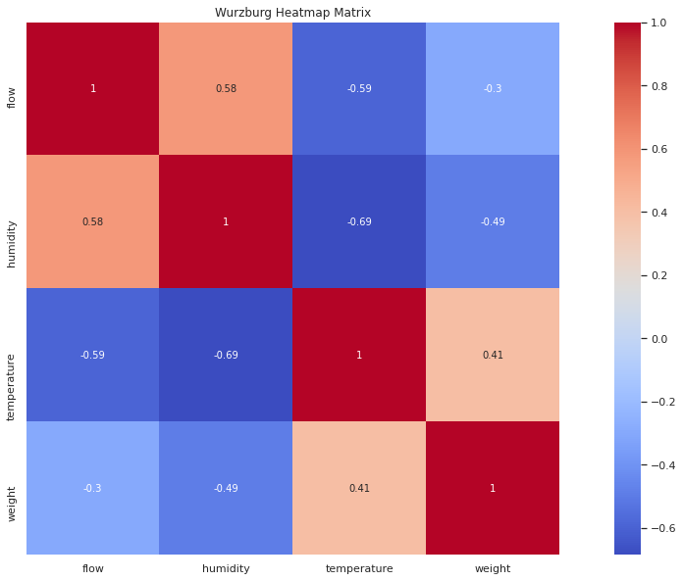
Heatmap Matrix

Slide 6
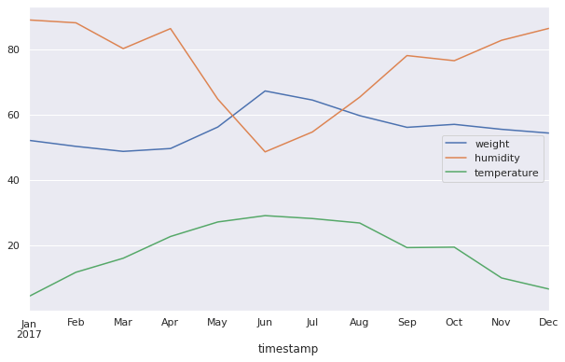
Temperature, Weight & Humidity Correlation
Notes:
shows that May and June have the greatest temperatures but the lowest humidity. Higher temperatures cause bees to work and increase the hive weight, which is the result of them producing more honey. Weight increase means honey production “more honey” and weight begins to rise in June, just as flowers blossom. Low humidity and high temperatures are needed to increase bee’s activity and production which has been proven by many different studies

Slide 7
Thank you

